Slide 1
ARIMA models for forecasting
Non-technical introduction
Vardan Baghdasaryan

Slide 2
ARIMA basic structure
A non-seasonal ARIMA model is classified as an "ARIMA(p,d,q)" model, where:
p is the number of autoregressive terms,
d is the number of nonseasonal differences needed for stationarity, and
q is the number of lagged forecast errors in the prediction equation.
General forecasting equation is:
ŷt = μ + ϕ1 yt-1 +…+ ϕp yt-p - θ1et-1 -…- θqet-q
Where if y denotes the d-th difference of Y, which means:
If d=0: yt = Yt
If d=1: yt = Yt - Yt-1

Slide 3
AR(p) model
ARIMA(p,0,0) = p-order autoregressive model:
if the series is stationary and autocorrelated, perhaps it can be predicted as a multiple of its own previous value, plus a constant. The forecasting equation in this case is (for p=1)
Ŷt = μ + ϕ1Yt-1
In general case:
Yt = μ + ϕ1Yt-1 + ϕ1Yt-2 … + ϕkYt-k + vt
Assignments:
How to determine p?
How to judge about the model accuracy?

Slide 4
Determining order of differencing (d)
Rule 1. If the series has positive autocorrelations out to a high number of lags, then it probably needs a higher order of differencing
Rule 2. You observe the situation described in Rule 1. Take the first difference and check autocorrelations. If lag-1 is zero or negative and all the others are small, there is no need for further differencing.
Rule 3. The optimal order of differencing is often the order of differencing at which the standard deviation is lowest.
See the assignment

Slide 5
AR and MA in ARIMA
Autocorrelation vs partial autocorrelation:
It is the correlation between two variables under the assumption that we know and take into account the values of some other set of variables.
For instance, consider a regression context in which y = response variable and x₁, x₂, and x₃ are predictor variables. The partial correlation between y and x₃ is the correlation between the variables determined taking into account how both y and x₃ are related to x₁ and x₂.
In regression, this partial correlation could be found by correlating the residuals from two different regressions: (1) Regression in which we predict y from x₁ and x₂, (2) regression in which we predict x₃ from x₁ and x₂. Basically, we correlate the “parts” of y and x₃ that are not predicted by x₁ and x₂.

Slide 6
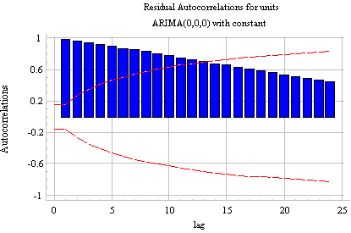
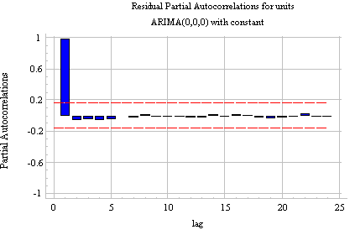
ACF vs PACF
Autocorrelations at lags 2 and above are merely due to the propagation of the autocorrelation at lag 1

Slide 7
Determining number of AR terms
By inspecting PACF you can determine how many AR terms you need to use to explain the autocorrelation pattern in a time series:
if the partial autocorrelation is significant at lag k and not significant at any higher order lags--i.e., if the PACF "cuts off" at lag k--then this suggests that you should try fitting an autoregressive model of order k
Note that in this particular case AR(1) model will be equivalent to first differencing. Can you explain why?

Slide 8
Dealing with differenced data. Determining AR signatures.
Rule 4: If the PACF of the differenced series displays a sharp cutoff and/or the lag-1 autocorrelation is positive--i.e., if the series appears slightly "under-differenced"--then consider adding an AR term to the model. The lag at which the PACF cuts off is the indicated number of AR terms.
AR term acts like “partial differencing” in the forecasting equation
If coefficient of AR(1) model is equal to 1 , then it is full first difference
If coefficient of AR(1) model is equal to 0, it has no impact

Slide 9
Dealing with differenced data. Determining MA signatures.
Rule 5: If the ACF of the differenced series displays a sharp cutoff and/or the lag-1 autocorrelation is negative--i.e., if the series appears slightly "over-differenced"--then consider adding an MA term to the model. The lag at which the ACF cuts off is the indicated number of MA terms.
MA partially cancel an order of differencing.
Consider ARIMA (0,1,1) model :
Ŷ_{t} = μ + Y_{t-1} - θ₁e_{t-1}
Make sure that you understand that this is a SES model. ☺
So if theta = 1, it completely cancels out differencing.

Slide 10
Practice with ARIMA (0,1,1)
We note that our data needs 1 order of differencing.
Example suggests to use 2 AR signatures
Check that this is a valid claim by applying the steps provided to you.
Now consider an alternative dataset on Armenia Economic Activity. Load the dataset and try to predict Economic activity level in February and March of 2018.

